Slide 1
Publishing options:
Slovenia institute associated corresponding authors

Slide 2
Key information
How do we determine eligibility of the article for the Slovenia agreement?
The acceptance date of the article should be on or after the start date of the agreement (1st January 2022)
The corresponding author must be affiliated with a participating institution in the agreement
The article must be from a participating journal

Slide 3
Key information
2. Role of the institutional Librarian/Admin in the Elsevier OA Platform (EOAP)
By the time the article is in your EOAP, we have published the first version of the article in ScienceDirect (within 48 hours of acceptance)
You therefore do not approve the publication of the article; you validate whether the corresponding author can make use of the APC funding under the agreement
As an agreement administrator, you have full rights to decide whether the author is eligible for the agreement

Slide 4
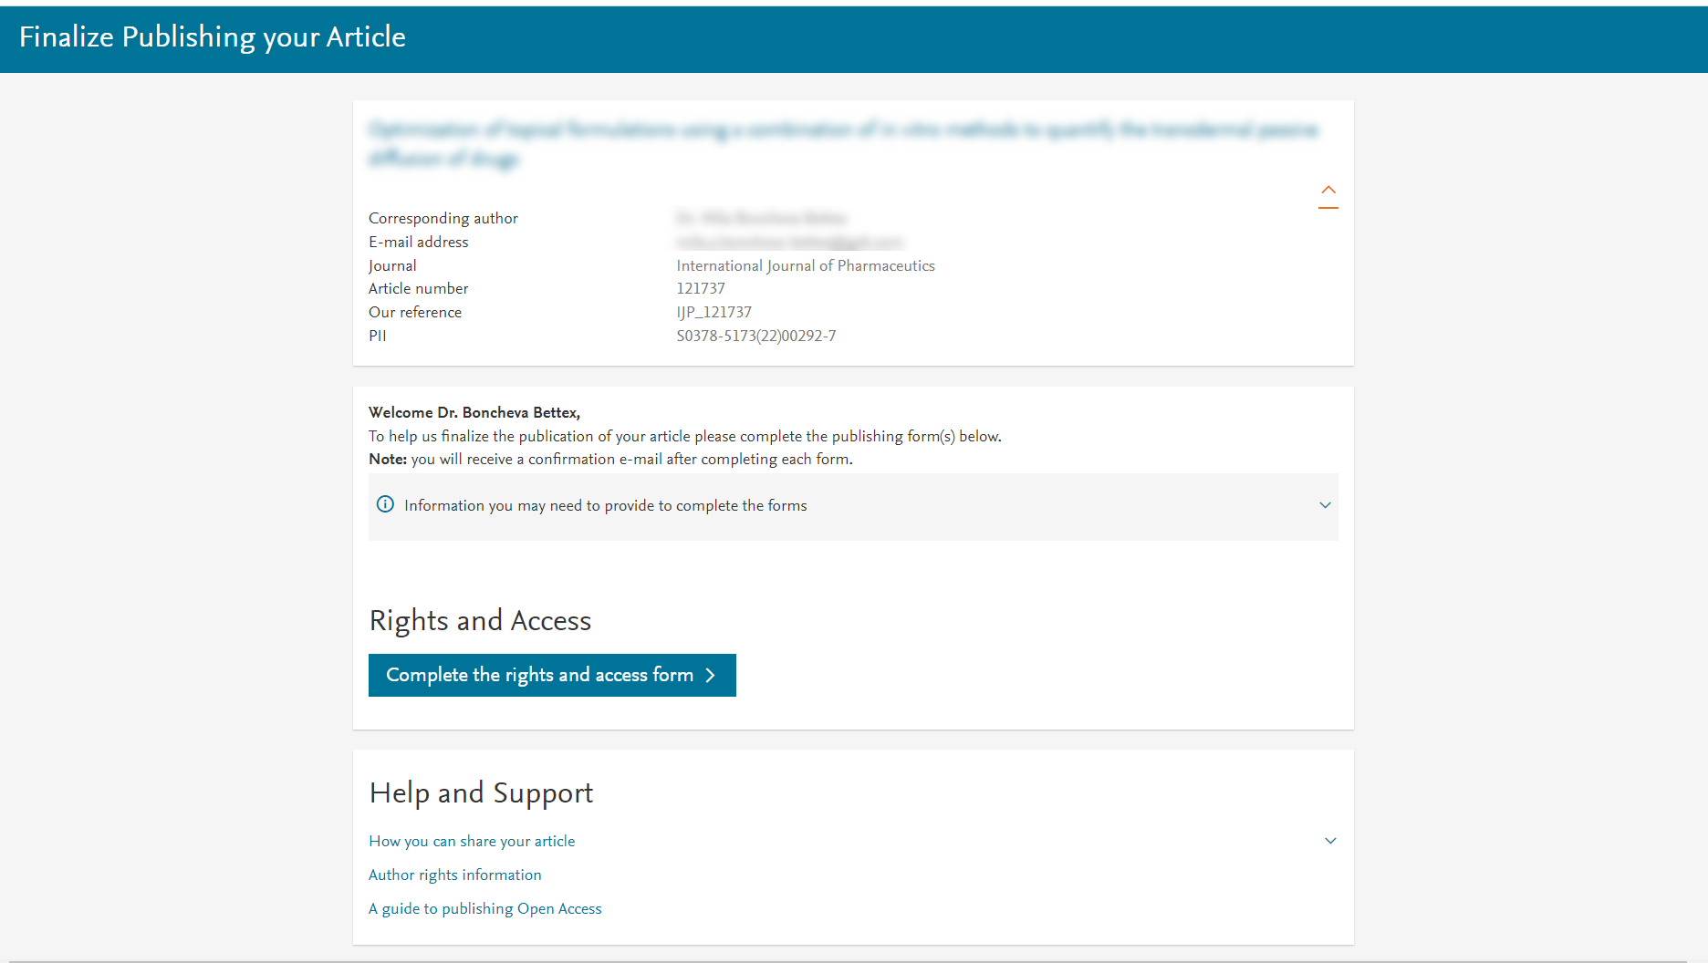
Corresponding author receives an email post acceptance with a link a unique link to complete the author journey and choose publishing options
Author clicks on Complete the Rights and Access information form

Slide 5
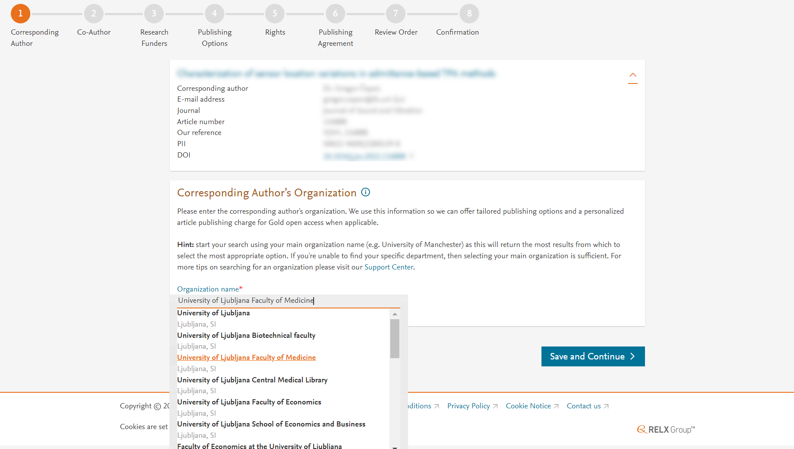
Corresponding author selects his/her affiliation details which we use to identify the authors and match them to the Slovenia agreement

Slide 6
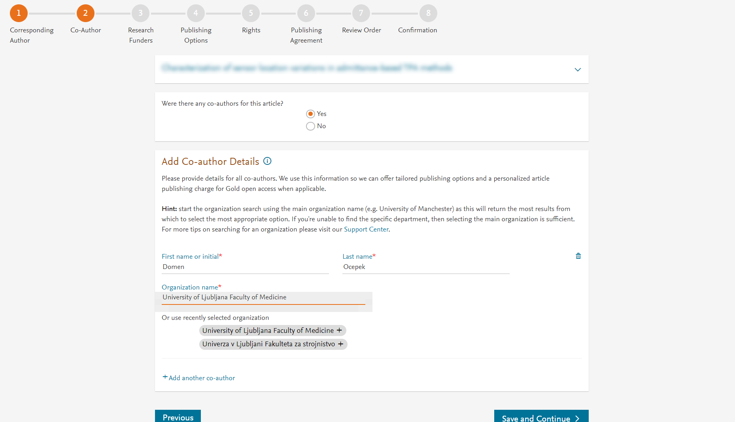
Corresponding author also adds the co-author affiliation details

Slide 7
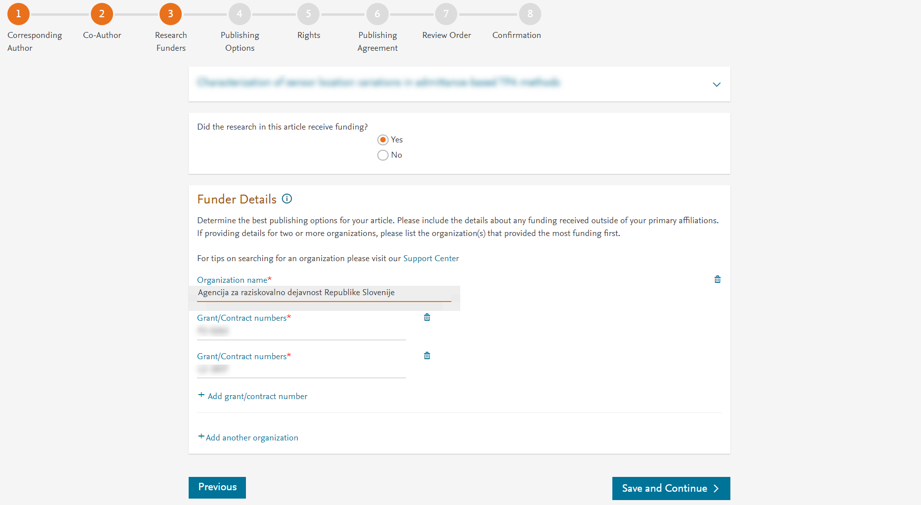
Author can add the Funder details. Funder can be the affiliated institute or a different one.

Slide 8
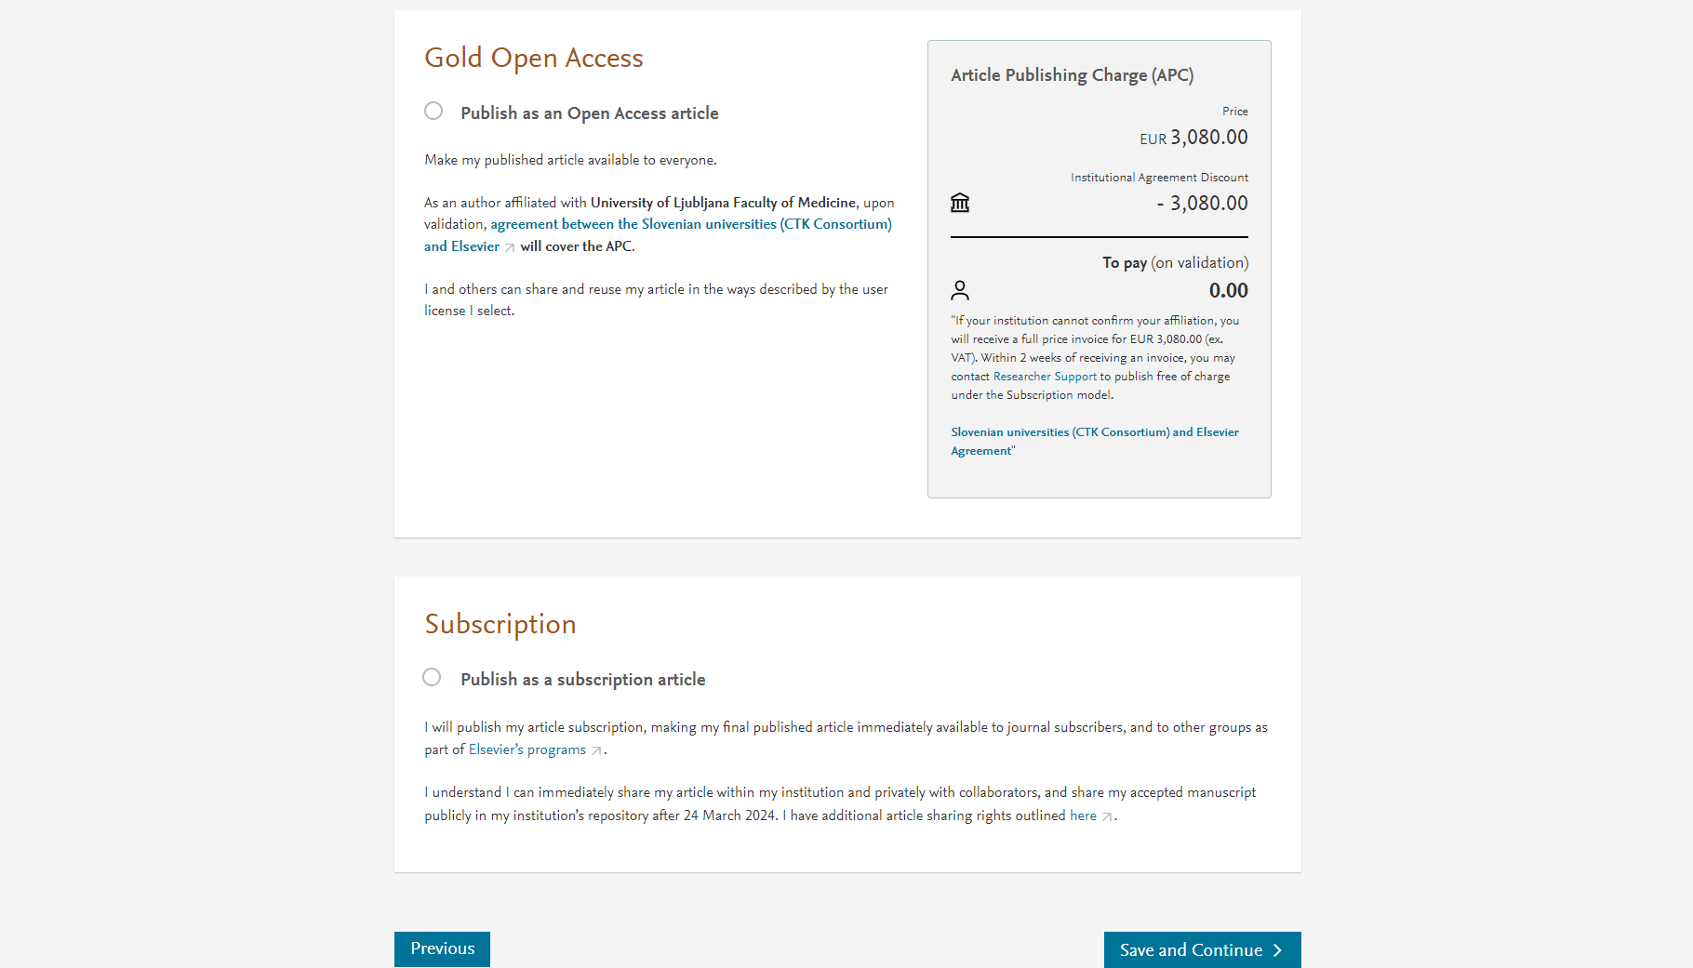
Current publishing options page in a Hybrid journal
Based on the affiliation details, the author sees the Publishing Options. Gold OA option is followed by Subscription option, and we inform the author that agreement covers the APC
If the librarian at the institution rejects the author request in the Elsevier Platform, we also make it clear that the authors will receive a full price invoice
Author selects OA

Slide 9
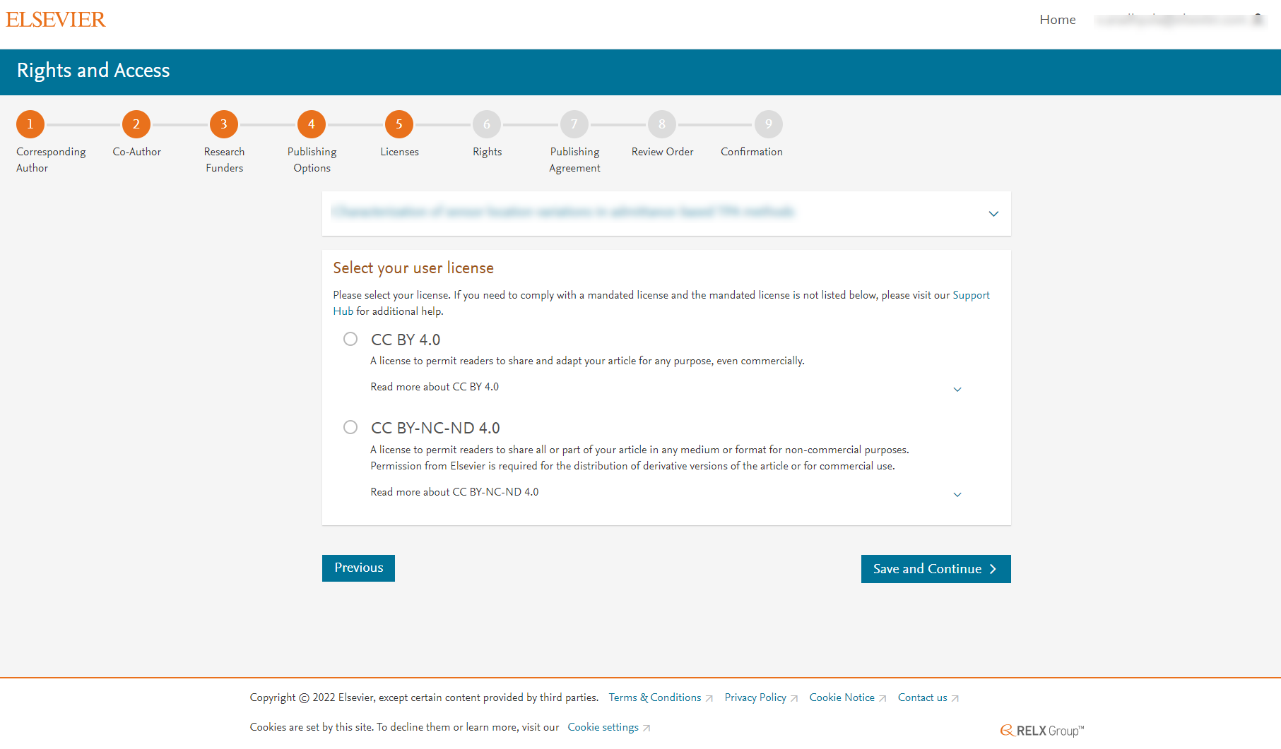

Slide 10
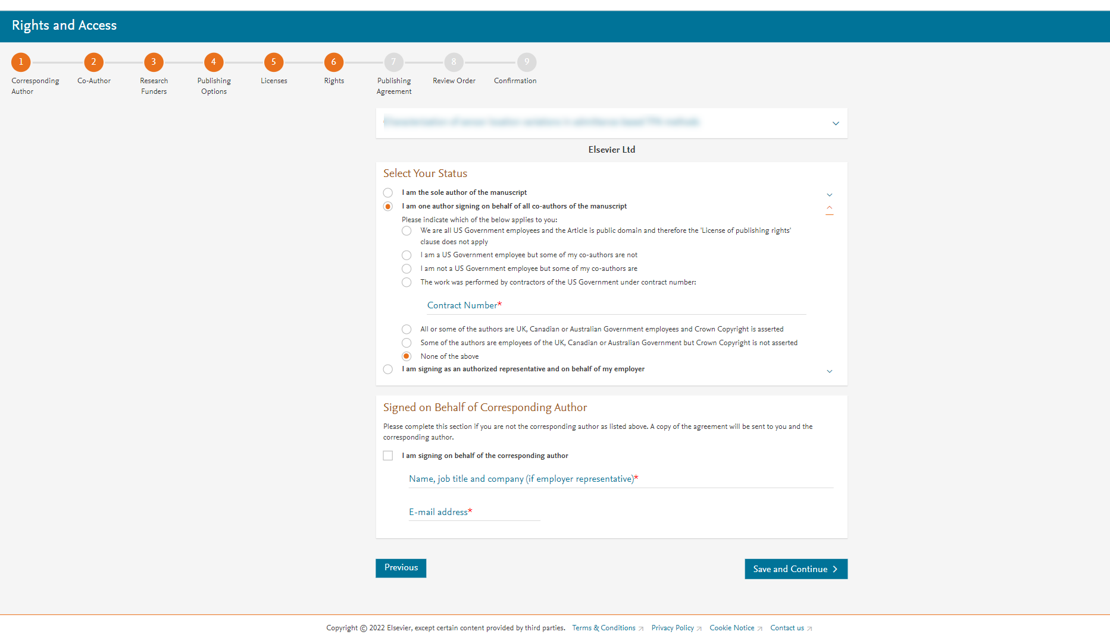
Author selects the rights

Slide 11
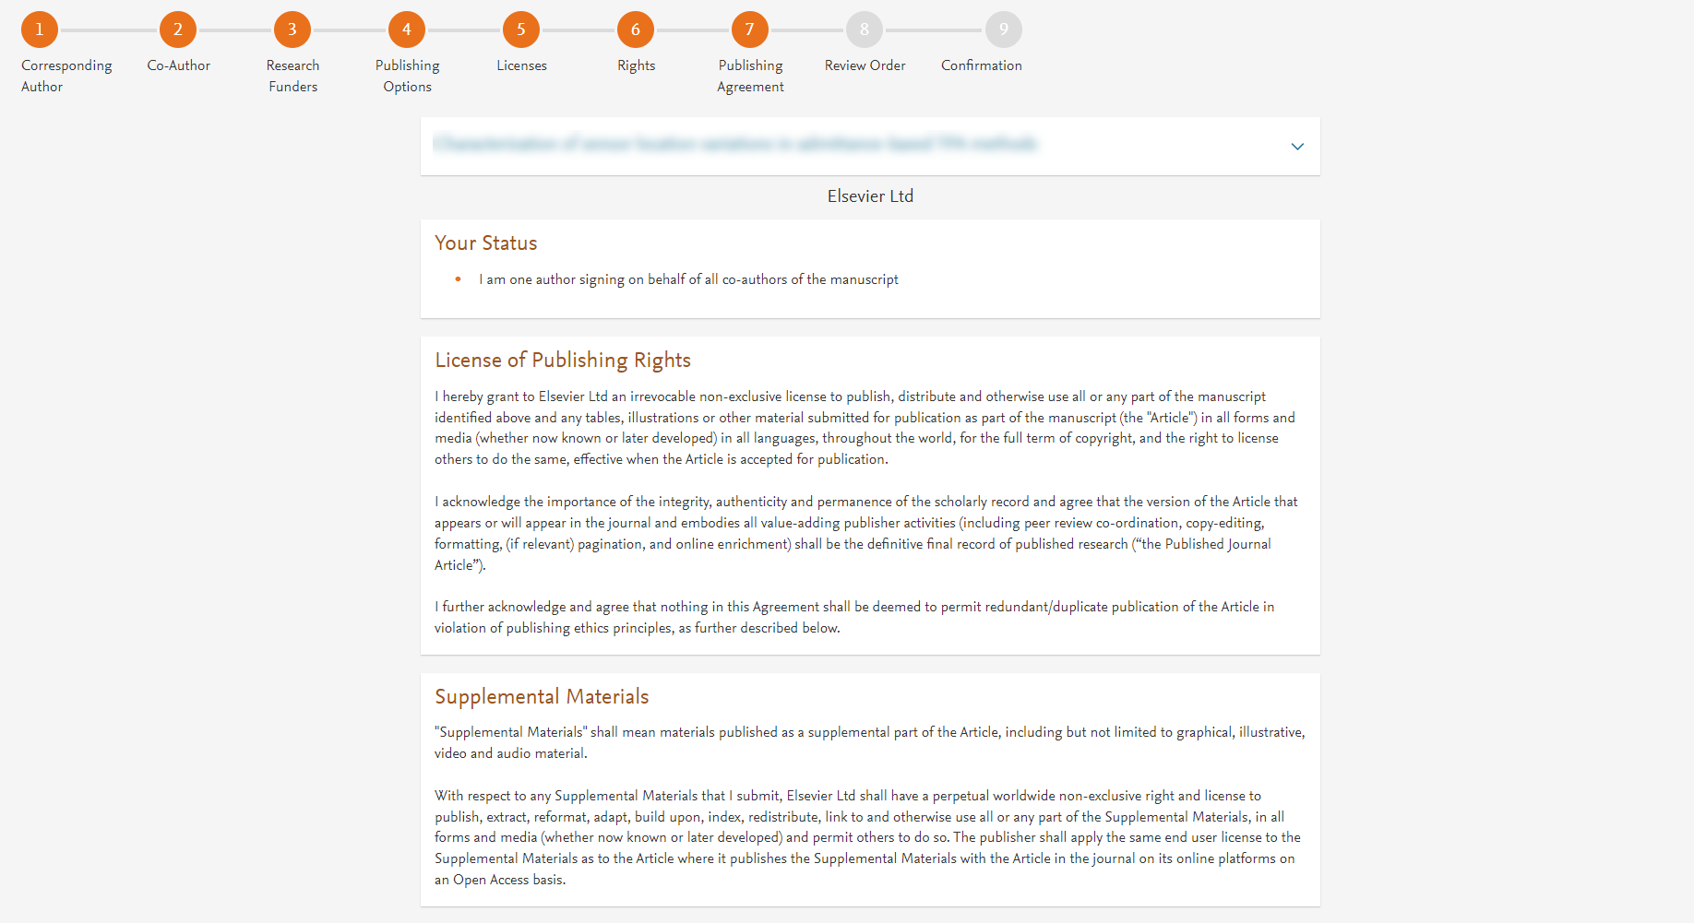
System presents author with the Journal License Publishing Agreement

Slide 12
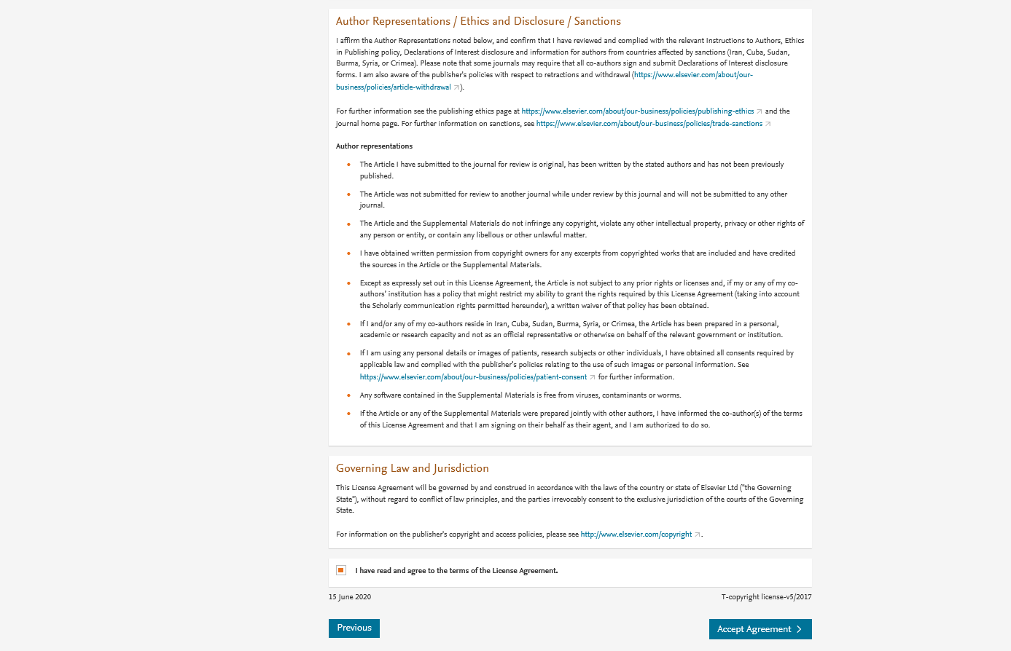
Authors agrees to the Journal License Publishing Agreement

Slide 13
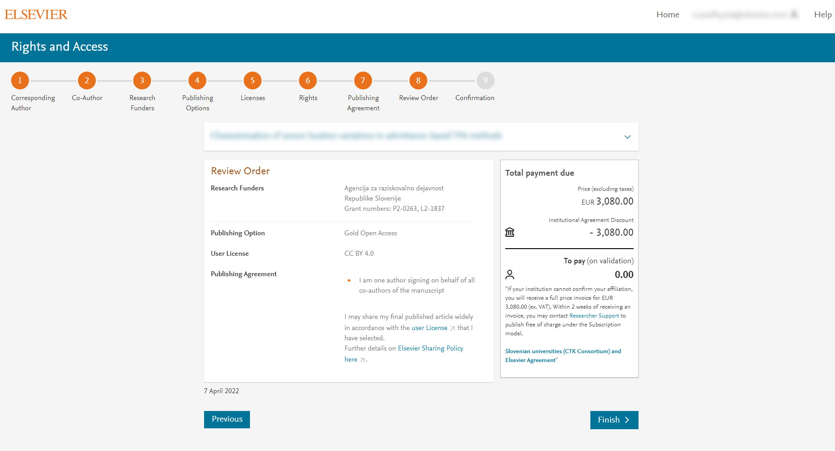
This is the summary page explaining the choices the author made in the publishing journey
Corresponding author and coauthors receive a copy of summary via email
Article becomes OA on ScienceDirect within 24 hours
Librarian receives a notification to validate the APC request within 48 hours who then has 3 weeks to validate the request

Slide 14
Support for authors and librarians
Author queries – support@elsevier.com
Librarian queries, EOAP account set up or changes – agreementactivation@elsevier.com
Author journey videos: https://service.elsevier.com/app/answers/detail/a_id/29789/supporthub/publishing/track/APN2ZgoIDv8a~RNiGvwa~yKgpv0qOS75Mv9e~zj~PP_X/

Slide 16
